Slide 1
Computer Graphics and Multimedia Systems
SCS1302
Unit 1

Slide 2
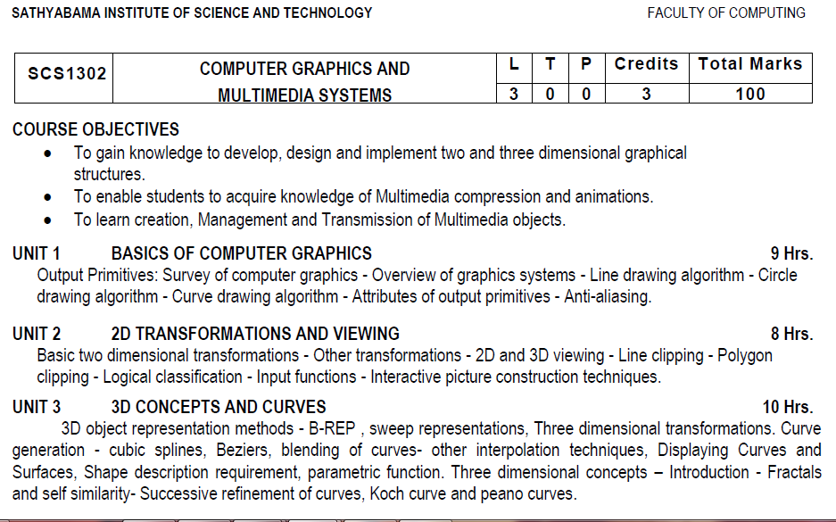
Syllabus

Slide 3
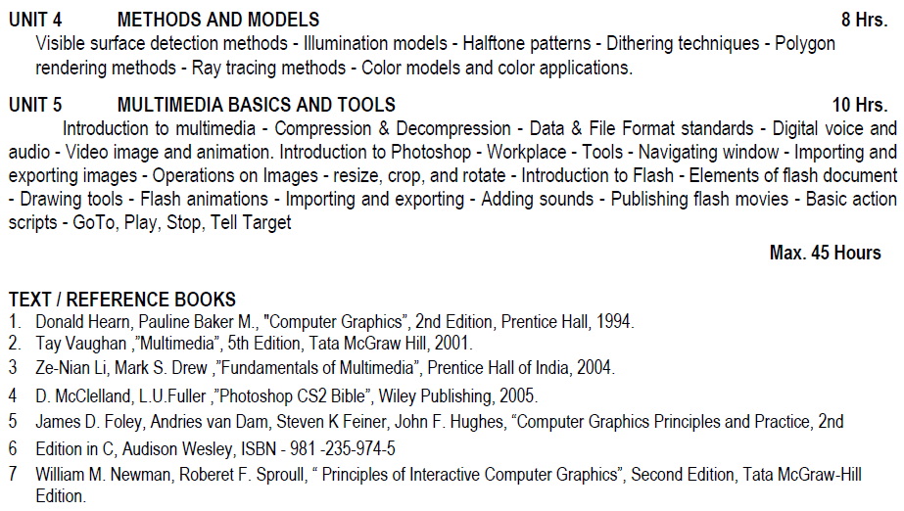
Syllabus

Slide 4
Course Objective(CO)
CO1: Construct lines and circles for the given input.
CO2: Apply 2D transformation techniques to transform the shapes to fit them as per the picture definition.
CO3: Construct splines, curves and perform 3D transformations
CO4: Apply colour and transformation techniques for various applications.
CO5: Analyse the fundamentals of animation, virtual reality, and underlying technologies.
CO6: Develop photo shop applications

Slide 5
Line Drawing Algorithms
A line connects two points. It is a basic element in graphics.
Line drawing algorithms:
  DDA Algorithm(Digital Differential Analyzer)
  Bresenham’s Line drawing Algorithm
To draw a line, you need two points between which you can draw a line
y=mx+c
Where, m is the slope , c is the y intercept

Slide 6
Digital Differential Analyzer (DDA) line drawing algorithm
The DDA is a scan conversion line algorithm based on calculating either dy or dx.
A line is sampled at unit intervals in one coordinate and corresponding integer values nearest the line path are determined for other coordinates.

Slide 7
Steps in DDA algorithm
Get the input of two end points
• Calculate the difference between two end points.
• Based on the calculated difference, If dx >dy, then number of steps = dx else number of steps =dy
• Calculate the increment in x coordinate and y coordinate.
• Put the pixel by successfully incrementing x and y coordinates the drawing of the line.

Slide 8
DDA
DDA Algorithm is the simplest line drawing algorithm.
Given the starting and ending coordinates of a line, DDA Algorithm attempts to generate the points between the starting and ending coordinates.

Slide 9
Procedure
Given
Starting coordinates = (X_{a}, Y_{a})
Ending coordinates = (X_{b}, Y_{b})
The points generation using DDA Algorithm involves the following steps-
Step-01:
Calculate dx,dy and m from the given input.
These parameters are calculated as-
dx= X_{b} – X_{a}
dy=Y_{b} – Y_{a}
m=dy/dx
and
X= X_{a}
Y= Y_{a}

Slide 10
Step-02:
Find the number of steps or points in between the starting and ending coordinates.
if (ab (dx) > abs (dy))
Steps = abs (dx);
else
Steps = abs (dy);

Slide 11
Step-03:
Find x increment and y increment,
Xincrement = dx/steps
Yincrement = dy/steps

Slide 12
Step-04:
Suppose the current point is (X_{k}, Y_{k}) and the next point is (X_{k+1}, Y_{k+1}).
Find the next point by following the below three cases-
Case 1 : m < 1
Case 2: m > 1
Case 3: m = 1

Slide 13
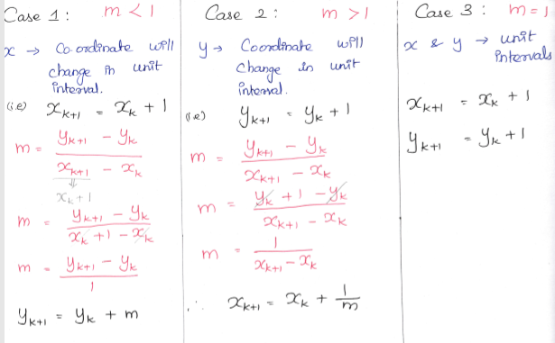

Slide 14
Step-05:
Keep repeating Step-04 until the end point is reached or the number of generated new points (including the starting and ending points) equals to the steps count.

Slide 15
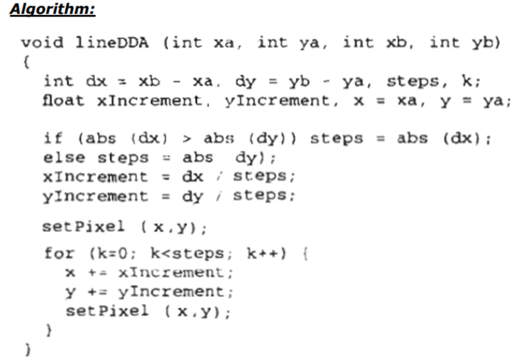
DDA algorithm

Slide 16
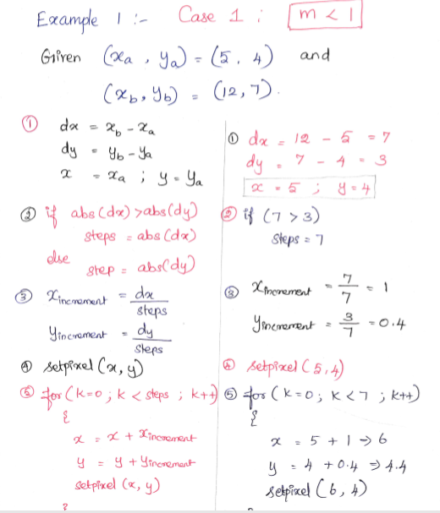

Slide 17
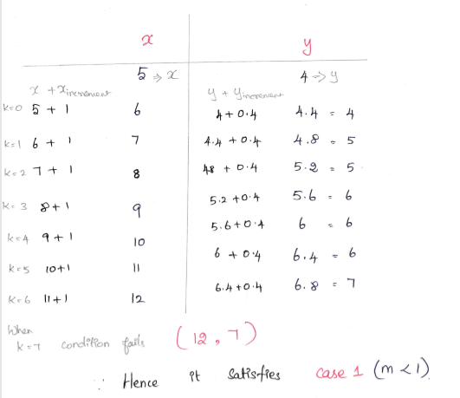
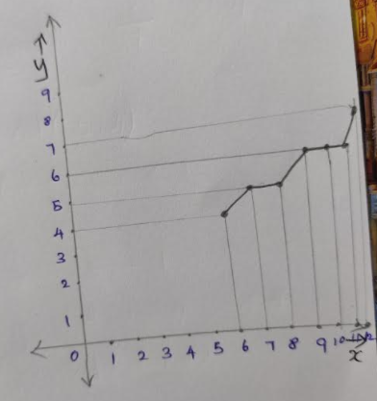

Slide 18
Example 2
Calculate the points between the starting point (5, 6) and ending point (8, 12).
Given-
Starting coordinates = (X₀, Y₀) = (5, 6)
Ending coordinates = (X_{n}, Y_{n}) = (8, 12)
Step-01:
Calculate ΔX, ΔY and M from the given input.
ΔX = X_{n} – X₀ = 8 – 5 = 3
ΔY =Y_{n} – Y₀ = 12 – 6 = 6
M = ΔY / ΔX = 6 / 3 = 2

Slide 19
Step-02:
Calculate the number of steps.
As |ΔX| < |ΔY| = 3 < 6, so number of steps
ΔY = 6
Step-03:
As M > 1, so case-03 is satisfied.
Now, Step-03 is executed until Step-04 is satisfied.

Slide 20
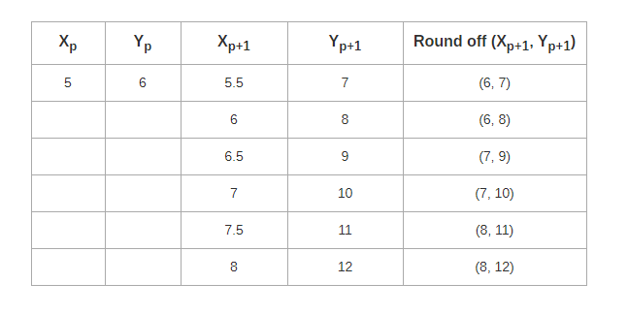

Slide 21
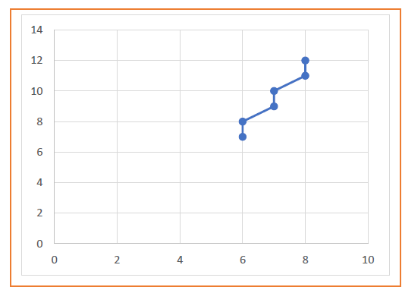

Slide 22
Example 3
Calculate the points between the starting point (5, 6) and ending point (13, 10).
Given-
Starting coordinates = (X₀, Y₀) = (5, 6)
Ending coordinates = (X_{n}, Y_{n}) = (13, 10)
Step-01:
Calculate ΔX, ΔY and M from the given input.
ΔX = X_{n} – X₀ = 13 – 5 = 8
ΔY =Y_{n} – Y₀ = 10 – 6 = 4
M = ΔY / ΔX = 4 / 8 = 0.50

Slide 23
Step-02:
Calculate the number of steps.
As |ΔX| > |ΔY| = 8 > 4, so number of steps = ΔX = 8
Step-03:
As M < 1, so case-01 is satisfied.
Now, Step-03 is executed until Step-04 is satisfied.

Slide 24
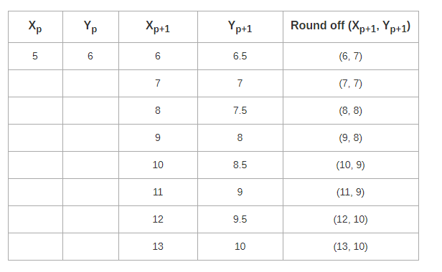

Slide 25
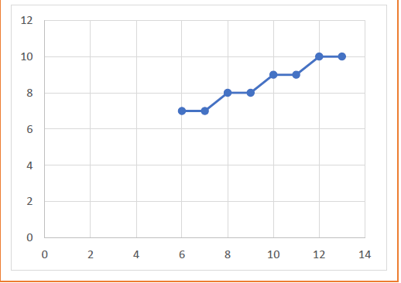

Slide 26
Example 4
Calculate the points between the starting point (1, 7) and ending point (11, 17).
Solution-
Given-
Starting coordinates = (X₀, Y₀) = (1, 7)
Ending coordinates = (X_{n}, Y_{n}) = (11, 17)
Step-01:
Calculate ΔX, ΔY and M from the given input.
ΔX = X_{n} – X₀ = 11 – 1 = 10
ΔY =Y_{n} – Y₀ = 17 – 7 = 10
M = ΔY / ΔX = 10 / 10 = 1

Slide 27
Step-02:
Calculate the number of steps.
As |ΔX| = |ΔY| = 10 = 10, so number of steps = ΔX = ΔY = 10
Step-03:
As M = 1, so case-02 is satisfied.
Now, Step-03 is executed until Step-04 is satisfied.

Slide 28
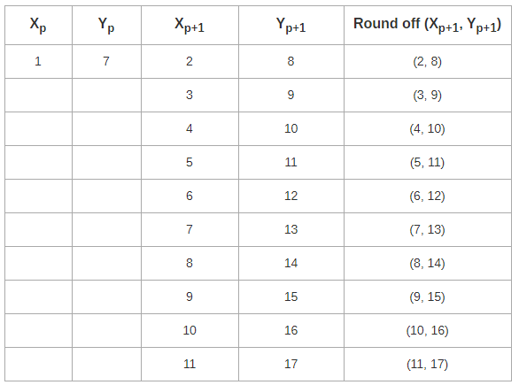

Slide 29
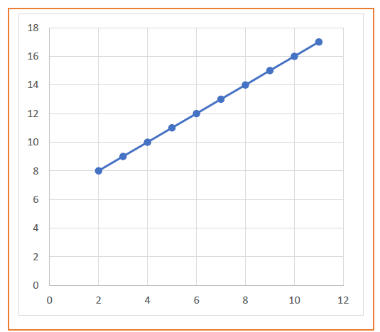

Slide 30
Bresenham’s Line Drawing Algorithm

Slide 31
Bresenhams Line Drawing Algorithm
This algorithm is used for scan converting a line.
It was developed by Bresenham.
It is an efficient method because it involves only integer addition, subtractions, and multiplication operations.
These operations can be performed very rapidly so lines can be generated quickly.

Slide 32
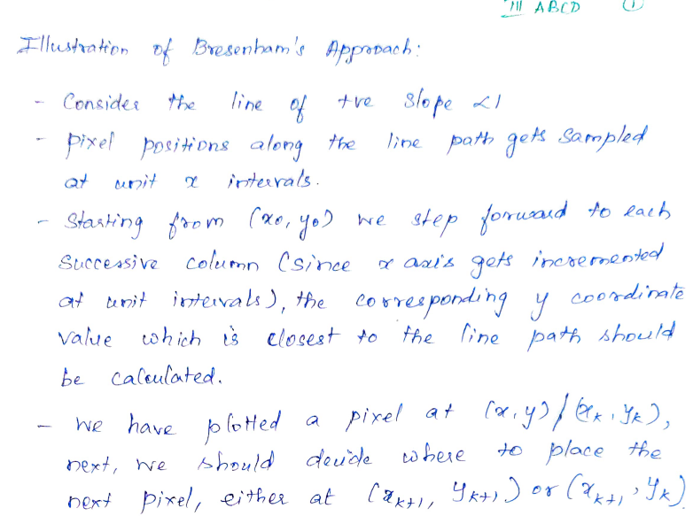
Bresenhams Line Drawing Algorithm

Slide 33
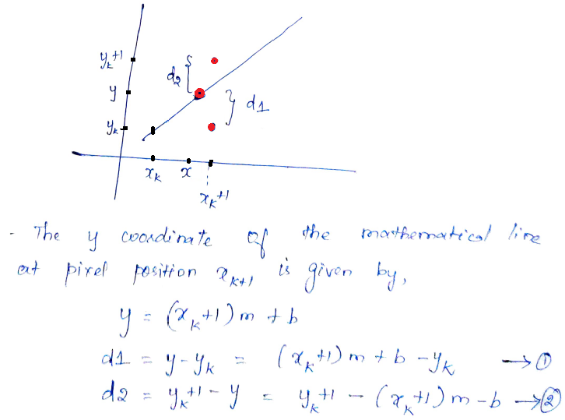
Bresenhams Line Drawing Algorithm

Slide 34
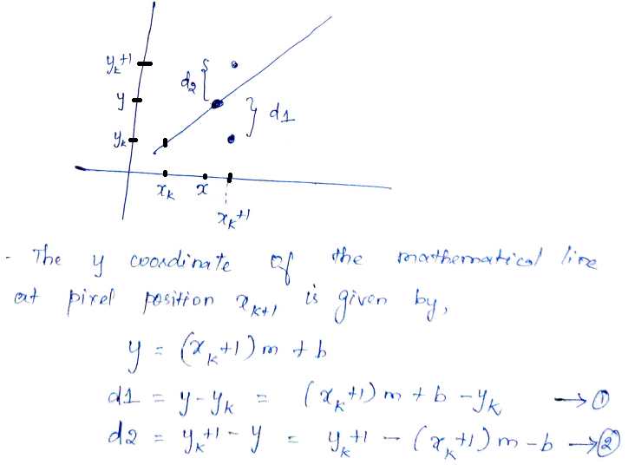
Bresenhams Line Drawing Algorithm

Slide 35
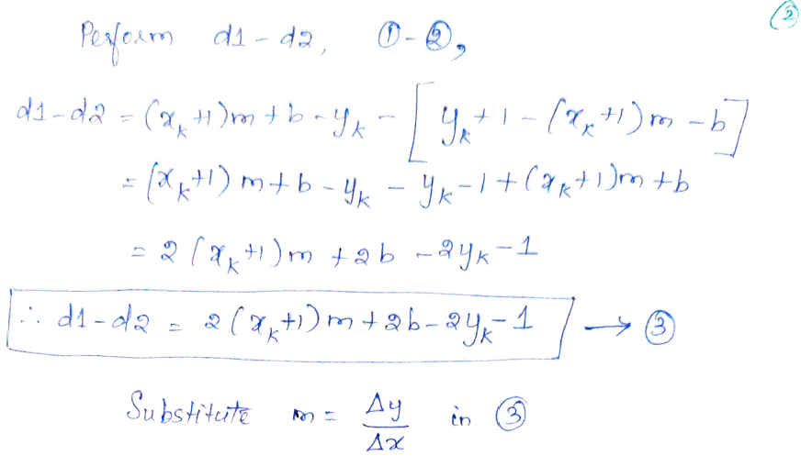
Bresenhams Line Drawing Algorithm

Slide 36
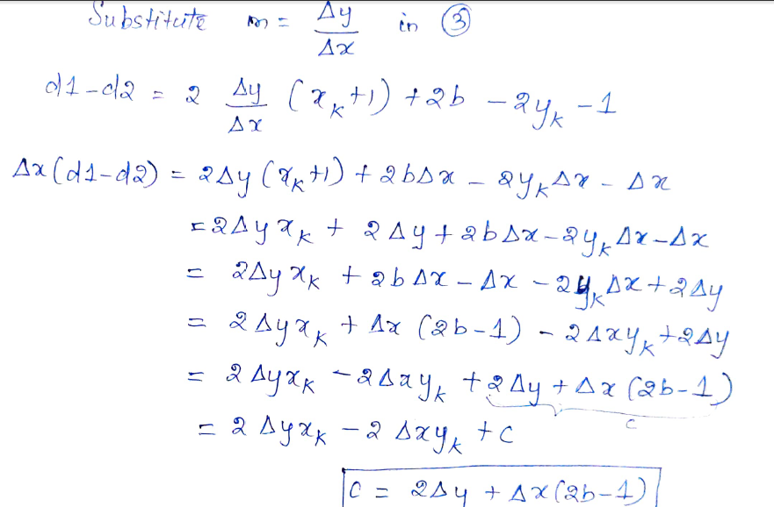
Bresenhams Line Drawing Algorithm

Slide 37
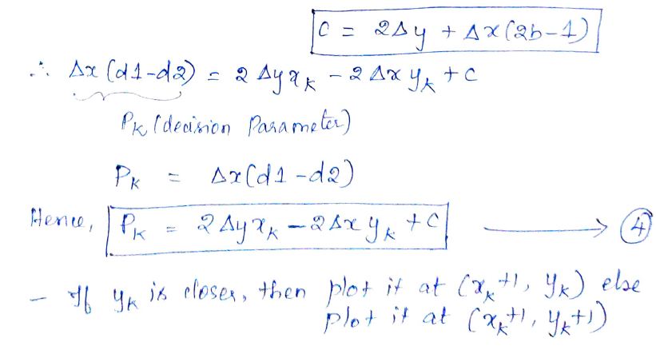
Bresenhams Line Drawing Algorithm

Slide 38
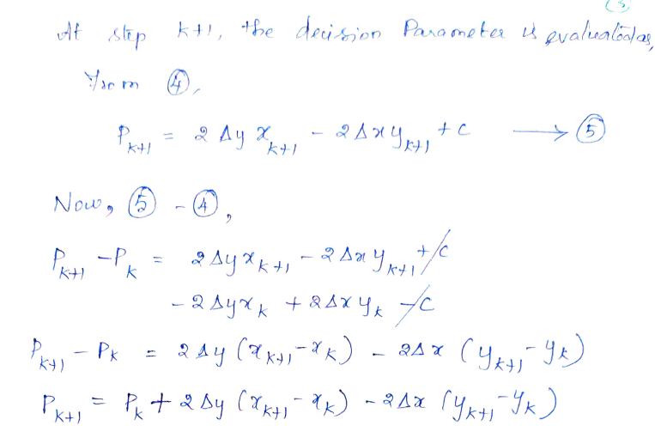
Bresenhams Line Drawing Algorithm

Slide 39
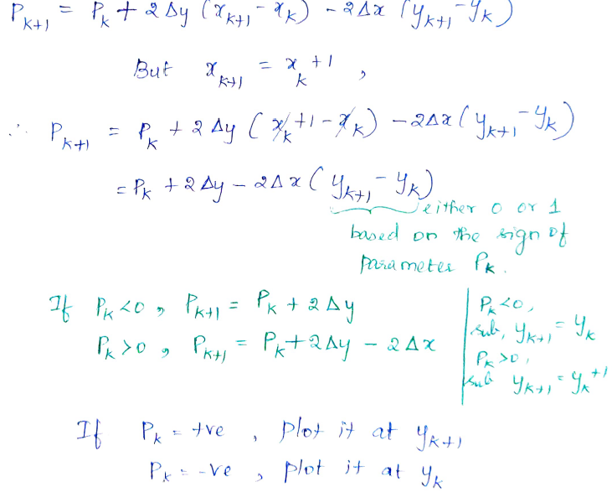
Bresenhams Line Drawing Algorithm

Slide 40
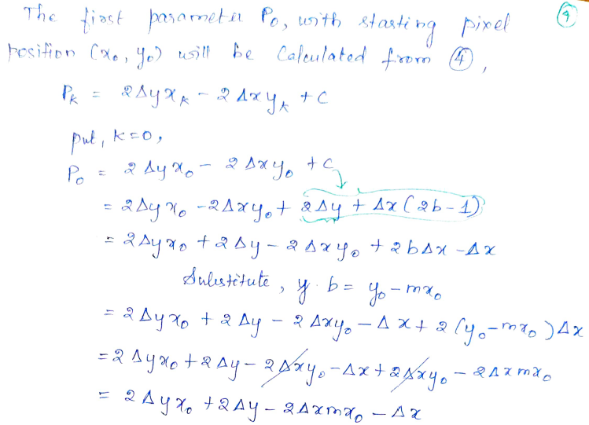
Bresenhams Line Drawing Algorithm

Slide 41
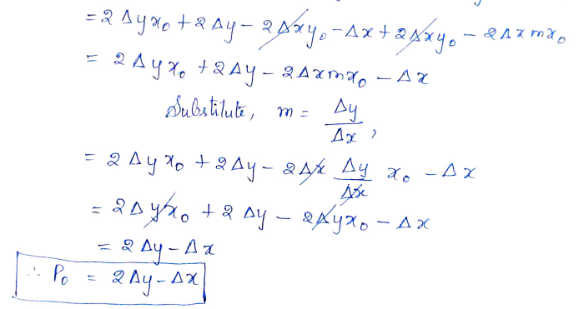
Bresenhams Line Drawing Algorithm

Slide 42
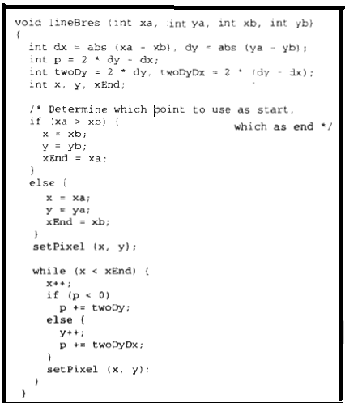
Bresenhams Line Drawing Algorithm

Slide 43
Example- Bresenhams Line drawing
Given (xa,ya)=(20,10) and (xb,yb)=(30,18)
Solution:
dx= 30-20 =10
dy= 18-10 = 8
P= 2*dy-dx
= 2*8-10
=6
twody= 2*dy = 2*8 = 16
twodydx= 2*(dy-dx)
= 2*(8-10)
= -4

Slide 44

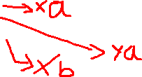
Example- Bresenhams Line drawing
If(20>30)
{ x=20; y=10; xend=30; }
setpixel(20,10);
while(20<30)
{ x=21;
If(6<0)
y=11;
p=6-4 = 2;
}
setpixel(21,11);

Slide 45



Example 1- Bresenhams Line drawing
0 | 6 | (21,11)
1 | 2 | (22,12)
2 | -2 | (23,12)
3 | 14 | (24,13)
4 | 10 | (25,14)
5 | 6 | (26,15)
6 | 2 | (27,16)
7 | -2 | (28,16)
8 | 14 | (29,17)
9 | 10 | (30,18)

Slide 46
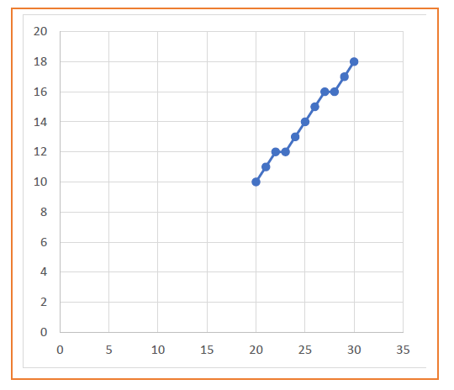
Example 1- Bresenhams Line drawing

Slide 47
Advantages of Bresenhams Line drawing algorithm
Disadvantage of DDA:
The accumulation of round of error is successive addition of the floating point increments is used to find the pixel position but it take lot of time to compute the pixel position.
Advantages of bresenham's line drawing algorithm.
The Bresenham line algorithm has the following advantages:
– An fast incremental algorithm
– Uses only integer calculations
The Bresenham algorithm is another incremental scan conversion algorithm
The big advantage of this algorithm is that it uses only integer calculations such as addition/subtraction and bit shifting.
The main advantage of Bresenham's algorithm is speed.
The disadvantage of such a simple algorithm is that it is meant for basic line drawing. The "advanced" topic of antialiasing isn't part of Bresenham's algorithm, so to draw smooth lines, you'd want to look into a different algorithm.

Slide 48
Advantages of bresenham's line drawing algorithm.
The advantages of Bresenham Line Drawing Algorithm are-
It is easy to implement.
It is fast and incremental.
It executes fast but less faster than DDA Algorithm.
The points generated by this algorithm are more accurate than DDA Algorithm.
It uses fixed points only.
Disadvantages of Bresenham Line Drawing Algorithm-
The disadvantages of Bresenham Line Drawing Algorithm are-
Though it improves the accuracy of generated points but still the resulted line is not smooth.
This algorithm is for the basic line drawing.
It can not handle diminishing jaggies.

Slide 49
Example 2
Calculate the points between the starting coordinates (9, 18) and ending coordinates (14, 22).

Slide 50
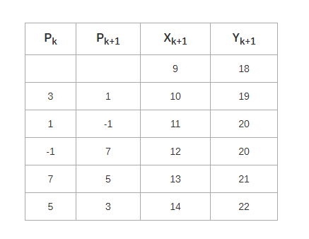
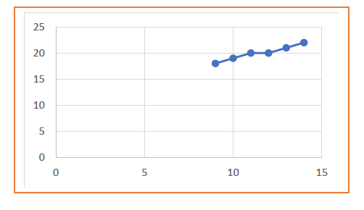
Example 2-cont…

Slide 51
https://developerinsider.co/download-turbo-c-for-windows-7-8-8-1-and-windows-10-32-64-bit-full-screen/
developerinsider.in/turbocpp

